Slide 1

Research Infrastructure Services for Sustainable Aquaculture, Fisheries and the Blue Economy 2024-2029
Adelino Canário - Coordinator
Funded by the European Union

Slide 2
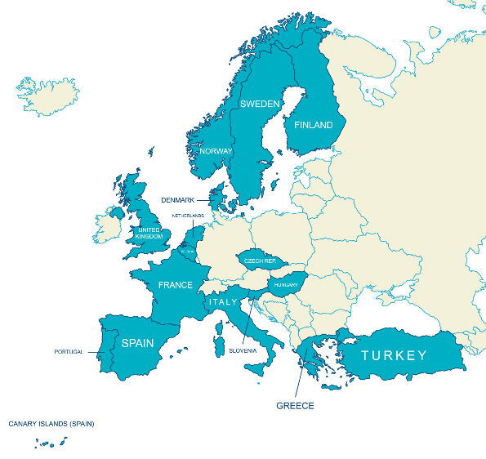
Partnerships (40)

Slide 3
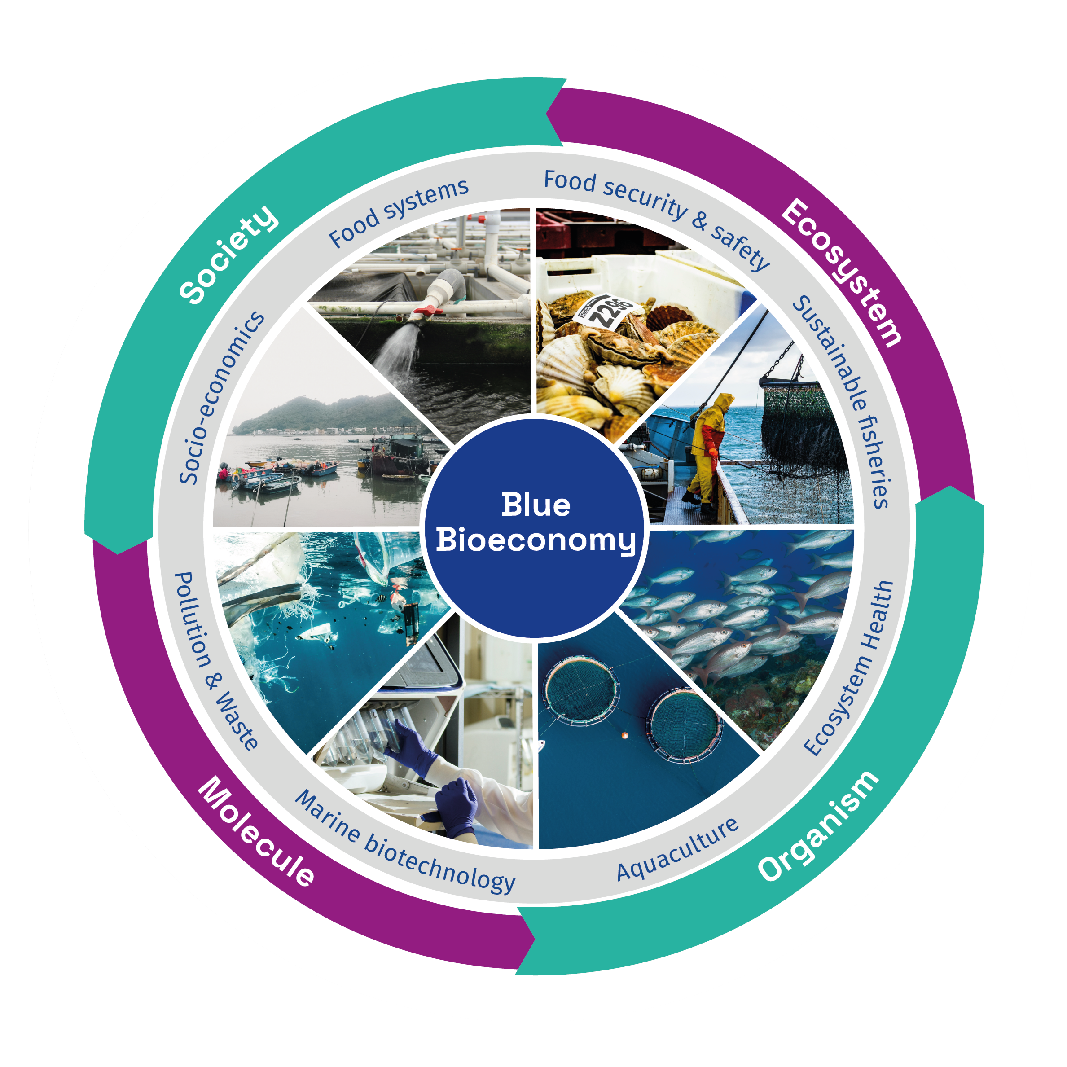
CALL: HORIZON-INFRA-2023-SERV-01-01: Research infrastructure services to enable R&I addressing main challenges and EU priorities
•Expected outcomes:
•provision of innovative, customised and efficient RI services enhancing and increasing society’s long-term and consistent problem-solving capacity and evidence-based policy making;
•enabling/facilitating R&I for sustainable aquaculture, fisheries and the blue economy;
•enhanced and further integrated RI capacities in support of the Common Fisheries Policy, the Farm to Fork Strategy, the sustainable blue economy and the European Green Deal.
•Training courses and ad hoc users’ training will prepare the new generations of researchers to properly exploit leading-edge RIs, and should provide them with appropriate skills for data stewardship

Slide 4
Conceptual Framework

Slide 5
Aquaserv Objectives
To offer unique, relevant, and cutting-edge integrated and customised services
  KPIs:
  120 services in the portfolio,
  80 annual requests,
  minimum of 300 applications.
To offer centralised and efficient transnational access through a user-friendly centralised gateway
  KPIs:
  6 months to the first call.
To reduce the time to arrive at the destination goals through joint research and training.
  KPIs:
  10 integrated multi-RI service offers
  15 joint research activities/customised services
  30 inter-RI training/fact-finding exchanges.

Slide 6
AQUASERV objectives (cont.)
To promote and implement measures to safeguard and ensure compliance with Open Science policies and complement and synergise with other relevant EU initiatives
  KPIs:
  75% of data is shared with EOSC, EMODNET, and/or related initiatives.
To ensure the sustainability of the RI network and internationalisation.
  KPIs:
  20% of services beyond those offered in AQUASERV are supported.
To develop an ambitious outreach and engagement programme
  KPIs:
  500,000 people reached through social media
  3,000 people participating in AQUASERV events and outreach activities.

Slide 7
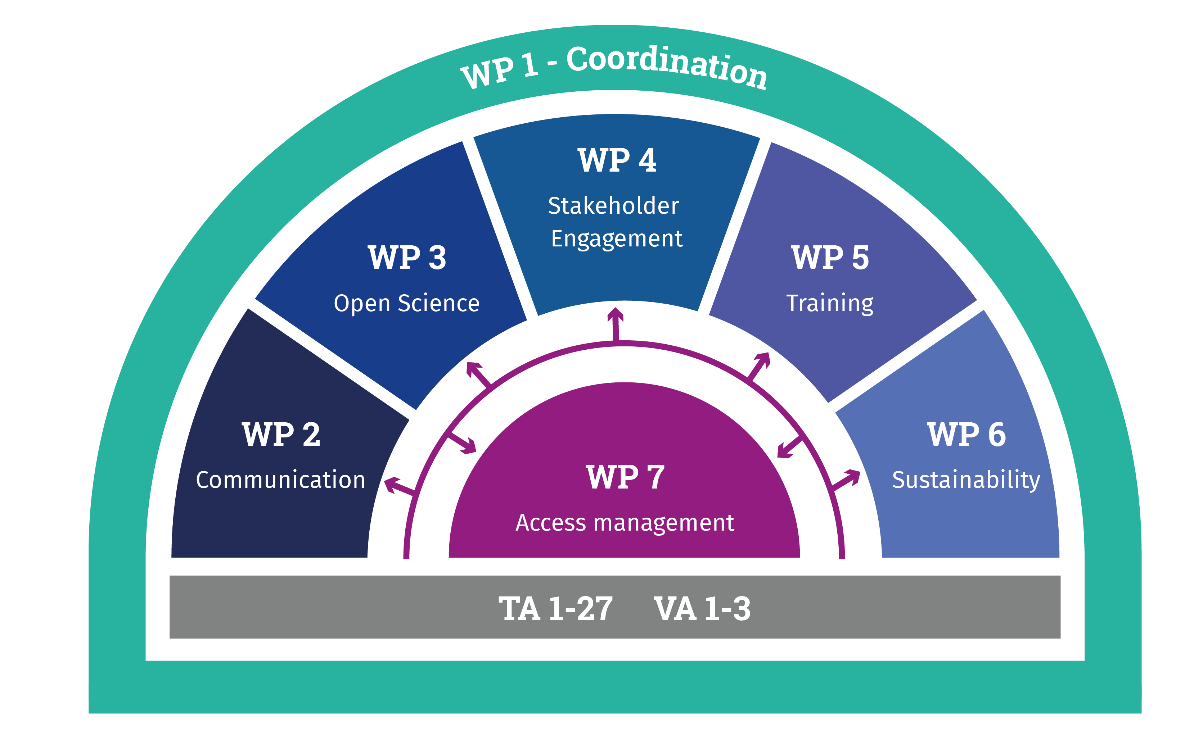
AQUASERV structure
32 Deliverables
17 Milestones
Budget ~70% TA/VA

Slide 8
EXECUTIVE COMMITTEE
(WP leaders)
• WP1: Adelino Canário (coordinator) and Ana Aranda (manager), CCMAR
• WP5: Maria Huete Ortega, UVIGO and Claudia Delgado, UGENT
• WP2: Andreia Pinto, CCMAR and Anabelle Chaumun, EMBRC
• WP6: Antti Kause, LUKE and Ibon Cancio, EHU
• WP3: Katrina Exter, VLIZ and Cymon Cox, CCMAR
• WP7: Davide Di Cioccio, EMBRC and Michel Boer, AnaEE
• WP4: Marc Vandeputte, INRAE and Antoine Schoen, UGE

Slide 9
Advisory Boards
The STAB (5 members) is composed of experts in the field and industry representatives to advise on operational aspects and provide strategic recommendations:
  To identify gaps and shortcomings in the service offer;
  To advise on the inclusion of additional key services related to the Blue Economy
  To drive the development of service customisation and decide with the ExCom which proposals for customisation are to be supported based on internal calls.
  To have a role in ensuring the best TA proposals are selected
2) The Ethics Advisory Board (2 members)
  To advise the ExCom and regularly review the nature of the ethical issues associated with TA projects
  To provide independent ethical expertise related to the use of animals in animal experimentation, endangered organisms and protected areas, use of genetic material, import and export of materials, and any other relevant ethical issues

Slide 10
WP2 - Communication, dissemination and outreach
Objectives
  To create a network of RI communications officers to effectively engage all the project partners
  To develop a communication toolkit.
  To disseminate the project.
  To engage with key audiences about the project activities.
  To provide outreach and increase societal understanding of the role of R&I and RIs in implementing EU policies.
Task 2.1 – Network of RI Communications Officers
Task 2.2 – Communication toolkit
Task 2.3 – Dissemination: attracting existing and new users of AQUASERV RI services
Task 2.4 – Communication: engaging with key audiences
  Organisation of two AQUASERV virtual conferences
Task 2.5 – Outreach: increasing societal understanding of the importance of research and innovation

Slide 11
WP3 - Open Science policy, data management, and service costumisation
Objectives
  To develop and implement a project data management plan.
  To facilitate service creation and customisation through increased data availability, re-usability, and integration.
  To enhance and add value to the FAIRness of digital services.
Task 3.1 – Project data management plan
Task 3.2 – Implementation of the project data management plan
Task 3.3 – Service creation and customisation through increased data availability, re-usability, and integration
  Internal call for service creation and customisation (Month 6-36)
Task 3.4 – Enhancing and adding value to the FAIRness of digital services

Slide 12
WP4 - ENGAGING WITH STAKEHOLDERS AND IMPACT
Objectives
  To map and manage a stakeholder group covering the necessary areas.
  To promote the industrial and social relevance of experimental research
  Identify the key results generated by TA and their potential end-users.
  Provide success stories as key items for promoting AQUASERV to potential RI users and the wider stakeholder groups.
  Measure the impact of TA in the AQUASERV perimeter.
Task 4.1 – Mapping the stakeholders’ universe.
Task 4.2 – Defining and populating a database of access results.
Task 4.3 – Build up TA success stories
  Calls for submission of (30) “success stories” (Month 24 onwards)
Task 4.4 - Measuring the impact of TA in the AQUASERV perimeter

Slide 13
WP5 - Training of users and research infrastructure staff
Objectives
  To map the training offer with the needs of potential end-users and RI staff and standardise training resources for online and/or blended delivery.
  To provide a common methodology and standard guidance for the training activities in the RIs and coordinate training delivery.
  To organise staff mobility and internships for hands-on practice and knowledge exchange
Task 5.1 – Mapping the stakeholders universe.
Task 5.2 – Design of the training resources
Task 5.3 - Training delivery
  30 training courses
Task 5.4 - Staff mobility programme delivery
  Continuous call for staff exchange

Slide 14
WP6 – AQUASERV sustainability and future challenges
Objectives
  To scan the service provision needs of industry, society, policy and science in the Blue Bioeconomy sector.
  To define protocols towards customisation and evolution of AQUASERV services.
  To integrate knowledge of user demand and RI performance outputs to identify future needs.
  To scan for potential RI collaboration and partnerships within and outside Europe.
  To develop a roadmap for sustainable AQUASERV service provision beyond the project duration in support of Blue Growth
Task 6.1 – Future needs of science, industry, policy, and society
Task 6.2 - Governance and funding to ensure the long-term sustainability of AQUASERV service provision
Task 6.3 - Roadmap for long-term use of AQUASERV beyond the project

Slide 15
WP7 - Access management of customized and integrated services
Objectives
  To design, implement and maintain a catalogue of integrated and customised services.
  To implement and manage access.
  To implement quality assurance through monitoring and reporting.
Task 7.1 - Catalogue of Services and TA application platform
Task 7.2 - Access Management
  Open calls, with no limitations of scope or topic, permanently open with cut-off dates every 4 months
  Challenge-driven calls every 8 months based on specific themes determined by an internal roadmap (ExCom/STAB)
Task 7.3 - Monitoring, quality control and continuous improvement of access

Slide 16
TA1-27/VA1-3 TA/VA access services
TNA access: 156,326 units
Estimated users: 472
Estimated applications: 332
Estimated weeks of access: 2415
VA access: 475,150 units

Slide 17
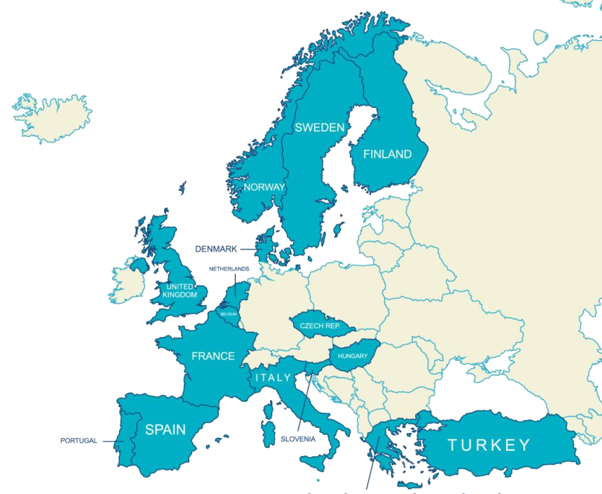
Transnational Access Programme
Who can apply?
Researchers from a recognized institution
Up to two users, up to 30 days (3 months)
Up to 20% from non-EU/associated countries
Transnational
What we offer
On-site and remote access
Standard consumables
Travel and subsistence expenses
Two types of calls
Open
Challenge-driven
Targets
300 TA users by March 2029
15% of users from industry
More than 10 early-career researchers
Notes:
Aquaculture
Fisheries
Biotechnology
Environment
Food / Social
Data

Slide 18
Two types of calls
Open call
Continuously open
Scope: Aquaculture, fisheries, and blue economy
No submission deadlines, but recommended submission dates
Evaluation every four months
75% of the total TA budget
Challenge-driven calls
Every eight months
Specific themes:
EU priorities based on an internal roadmap
Review: every 8 months
25% of the total TA budget
Notes:
Structure of the TNA calls and planning
Open calls and challenge-driven calls
AQUASERV will offer two types of calls for TA projects (WP7):
Open calls will represent ca. 75% of the total TA budget (~7.5M€). During the 5-year project a call for projects will be continuously open with no limitations of scope or topic starting on month 6, as soon as the catalogue of services is loaded onto the ARIA platform. Every 4 months cut-off dates will be organized to evaluate applications based on excellence, impact and quality by a TA review board composed of internal and external members (see TA review process).
Open calls, will have no limitations of scope or topic within the framework of aquaculture, fisheries and the blue economy, hence although we will advertise the opportunities and benefits provided by the wide range of technologies and disciplines available, it will be up to the user to take on the challenge.
Challenge-driven calls will represent ca. 25% of the total TA budget (~2.5M€). The periodic calls for proposals (every 8 months) will be based on specific themes that specifically address the main challenges and EU priorities object of the HORIZON-INFRA-2023-SERV-01-01 call (e.g., specific frontier fields/programmes, training for early stage scientists, cross-RI topics). The goal of these challenge topics is to support projects that show high complementarity to ongoing frontier projects from the open calls. The challenge-topics will be determined by an internal roadmap that will be developed and updated in alignment with the SEAB. The principles on the development of the roadmap will be established by the consortium at the start of the project.
Challenge-driven calls, however, will be based on specific themes determined by an internal roadmap that will be developed and updated by the ExCom in consultation with the SEAB and WP3. The road map will target primarily complex issues that require interdisciplinary approaches and possibly larger teams to be tackled. The principles on the development of the roadmap will be established by the consortium at the start of the project and its efficacy will be continuously monitored (WP7).
support frontier research areas, key EU priorities, and promote collaborations with industry within and beyond the blue economy to maximize its potential.
AQUASERV will promote challenge driven calls every 8 months (focusing on contributing to EU policies and Horizon Europe mission "Restore our Ocean and Waters 2030"). Task 7.3 will analyse data about TA and specific measures can be taken as a result, e.g., prioritizing specific user groups (aiming for at least 15% industry).
Timing of the calls
See also: https://docs.google.com/spreadsheets/d/1baZCtLnc2hiBB1ZxeFNIf7etqMn7Mhvm9cr2L4J0tjY/edit#gid=1106020150

Slide 19

Two types of calls
Launch 15 November
Open call
Continuously open
Scope: Aquaculture, fisheries, and blue economy
No submission deadlines, but recommended submission dates
Evaluation every four months
75% of the total TA budget
Checks and review
Up to 4 months
Eligibility, Feasibility, Scientific review, USP validation
Cut-off every four months
March, July, November
Notes:
Structure of the TNA calls and planning
Open calls and challenge-driven calls
AQUASERV will offer two types of calls for TA projects (WP7):
Open calls will represent ca. 75% of the total TA budget (~7.5M€). During the 5-year project a call for projects will be continuously open with no limitations of scope or topic starting on month 6, as soon as the catalogue of services is loaded onto the ARIA platform. Every 4 months cut-off dates will be organized to evaluate applications based on excellence, impact and quality by a TA review board composed of internal and external members (see TA review process).
Open calls, will have no limitations of scope or topic within the framework of aquaculture, fisheries and the blue economy, hence although we will advertise the opportunities and benefits provided by the wide range of technologies and disciplines available, it will be up to the user to take on the challenge.
Challenge-driven calls will represent ca. 25% of the total TA budget (~2.5M€). The periodic calls for proposals (every 8 months) will be based on specific themes that specifically address the main challenges and EU priorities object of the HORIZON-INFRA-2023-SERV-01-01 call (e.g., specific frontier fields/programmes, training for early stage scientists, cross-RI topics). The goal of these challenge topics is to support projects that show high complementarity to ongoing frontier projects from the open calls. The challenge-topics will be determined by an internal roadmap that will be developed and updated in alignment with the SEAB. The principles on the development of the roadmap will be established by the consortium at the start of the project.
Challenge-driven calls, however, will be based on specific themes determined by an internal roadmap that will be developed and updated by the ExCom in consultation with the SEAB and WP3. The road map will target primarily complex issues that require interdisciplinary approaches and possibly larger teams to be tackled. The principles on the development of the roadmap will be established by the consortium at the start of the project and its efficacy will be continuously monitored (WP7).
support frontier research areas, key EU priorities, and promote collaborations with industry within and beyond the blue economy to maximize its potential.
AQUASERV will promote challenge driven calls every 8 months (focusing on contributing to EU policies and Horizon Europe mission "Restore our Ocean and Waters 2030"). Task 7.3 will analyse data about TA and specific measures can be taken as a result, e.g., prioritizing specific user groups (aiming for at least 15% industry).
Timing of the calls
See also: https://docs.google.com/spreadsheets/d/1baZCtLnc2hiBB1ZxeFNIf7etqMn7Mhvm9cr2L4J0tjY/edit#gid=1106020150

Slide 20
Workflow – Access step by step
Contact access provider
Before application (optional)
Eligibility check
Evaluating application
Feasibility check
Scientific review
USP validation
Financial check
Hosting agreement & DMP
After application approved, before access
Project execution
During access
Reporting
After access

Slide 21
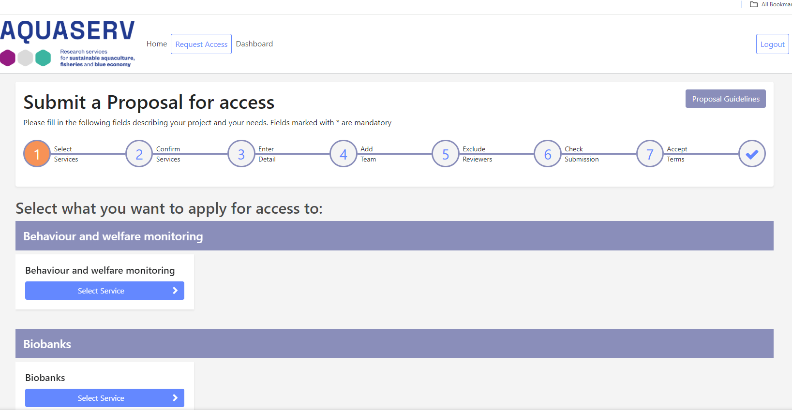
Pre-
application
Eligibility
Feasibility
Scientific
review
USP
validation
Financial
check
Preparation
TA project
Reporting
  Proposal on ARIA
  https://aria.aquaserv-ri.eu

Slide 22
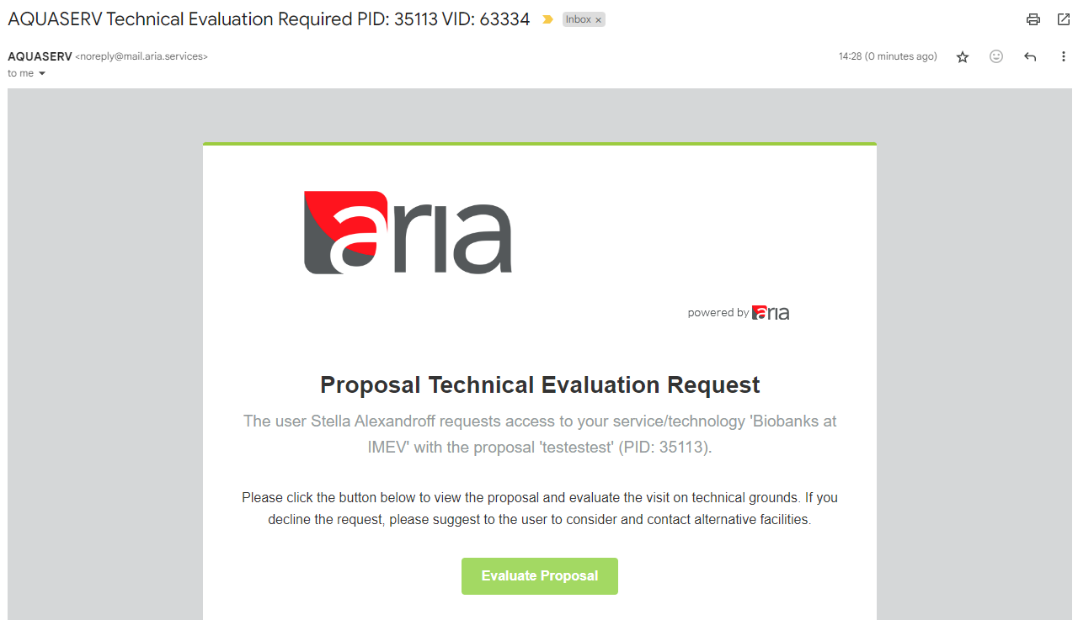
Pre-
application
Eligibility
Feasibility
Scientific
review
USP
validation
Financial
check
Preparation
TA project
Reporting
  Eligibility
  Checked by Access Officer
  Criteria in handbook and on website
  Feasibility
  Checked by Access Managers
Assessment of technical feasibility
Technical aspect only – not checking scientific merit
  → Technical Evaluation on ARIA

Slide 23
Pre-
application
Eligibility
Feasibility
Scientific
review
USP
validation
Financial
check
Preparation
TA project
Reporting
  Scientific review
Scientific excellence
Novelty of the proposal
Probability of delivery
Compliance with call priorities
Need for access
  Additional selection criteria
Compliance with ethics policy
Bonus points
  New users
  Users from Ukraine
  Early-career researcher
Who:
Access Officer
User Selection Panel (ExCom + STAB)
  Ensures consistency
  Resolves conflicting reviews
Who: Two external reviewers (compensated)
NB: At least 50% must be external

Slide 24

Pre-
application
Eligibility
Feasibility
Scientific
review
USP
validation
Financial
check
Preparation
TA project
Reporting
Hosting agreement
Terms of reference
Dates, service provided, etc
Obligations and guidelines
Open science and data management
Acknowledgements (patents, publications, etc.)
“Light” document
Additional contracts may be used by service provider
Who:
Access Officer to provide template
Access Managers to customise and send to user
Signed by all parties

Slide 25

Pre-
application
Eligibility
Feasibility
Scientific
review
USP
validation
Financial
check
Preparation
TA project
Reporting
Data Management Plan (DMP)
Guidelines on FAIR and open data
Before application:
  Need to know what FAIR and open means
  Need to agree to comply
Once application approved:
  Within a month (before access)
  Download DMP applicable to project type
Before project: Fill in as much as possible
After project: Fill in more
After analysis: Fill in more
OpenAIRE

Slide 26
Pre-
application
Eligibility
Feasibility
Scientific
review
USP
validation
Financial
check
Preparation
TA project
Reporting
  Applicant/User
  Feedback (ARIA)
  Activity report (ARIA)
    Within 45 days
    Achievements of objectives, potential outcomes
    Actual or potential end-users of results
  Finalisation of DMP
  Access Manager
  Confirmation of Access
    For audits
    Template provided
    Signed by both parties
  Feedback (ARIA)

Slide 27


Thank you !
Funded by the European Union. Views and opinions expressed are, however, those of the author(s) only and do not necessarily reflect those of the European Union. The European Union cannot be held responsible for them.
E-mail: aquaserv@ualg.pt
Website: aquaserv-ri.eu

