Slide 1

2024-2029
Research Infrastructure Services for sustainable aquaculture, fisheries and the blue economy
Name Surname, Affiliation, Institute
Funded by the European Union

Slide 2


Slide 3



AQUASERV Offer
1. Funded Access
2. Virtual Access
3. Training
Over 40 institutions across Europe offer a customised and funded service catalogue, which can be accessed on-site or remotely.
AQUASERV provides access to extensive databases, software and other web services through its virtual access programme.
​Our advanced training programme will capacitate researchers, staff and future users of the AQUASERV services

Slide 4
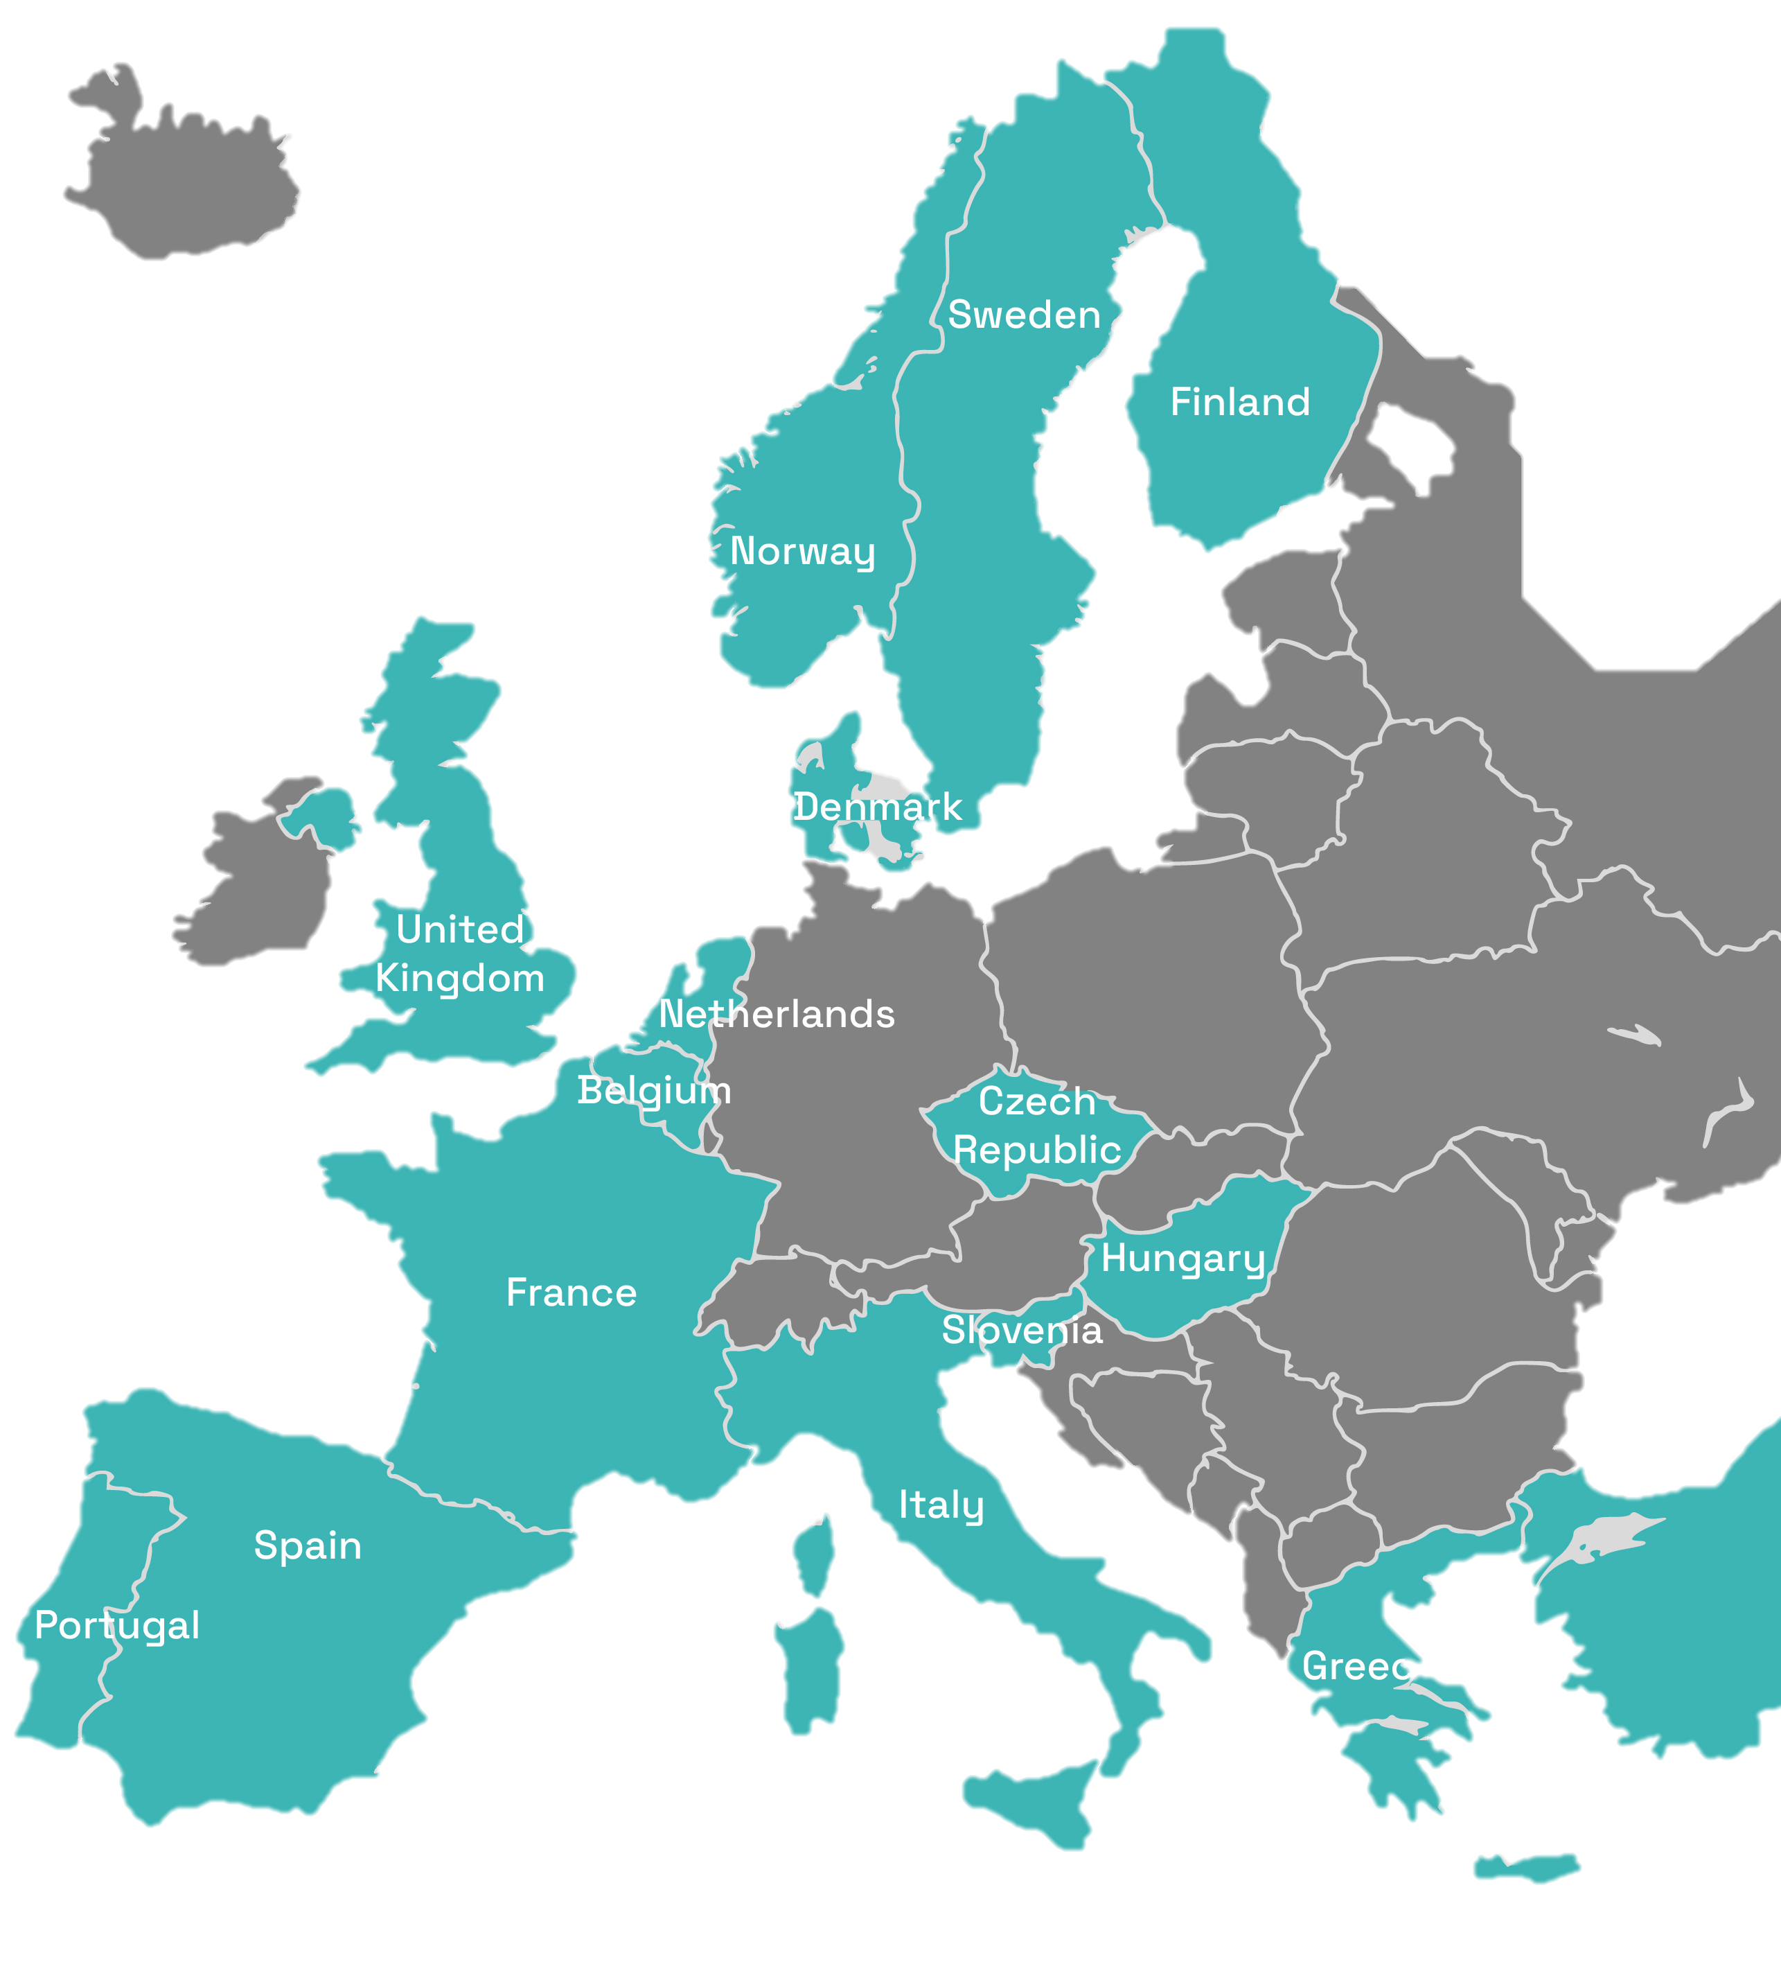
1. Funded Access
Transnational Access Programme
AQUASERV has launched an 8.5 million euros Funded Access Programme to support and fund researchers from academia and industry in Europe and around the world in developing research projects at leading European research facilities.
60
+600
16
facilities
services
countries

Slide 5
1. Funded Access
Transnational Access Programme
What we offer?
An extensive service catalogue:
On-site and remote access
Standard consumables
Travel and subsistence expenses

Slide 6
1. Funded Access
Transnational Access Programme
Researchers & Students:
PhD, Master’s degree, engineer’s degree, or equivalent.;
Affiliated with a recognized academic institution, a not-for-profit organisation, or a registered company.
Up to 20% from non-EU/associated countries
Who Can Apply?
There are two types of calls for access.

Slide 7
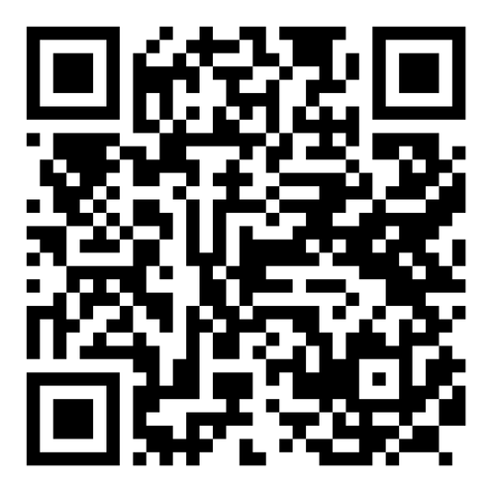
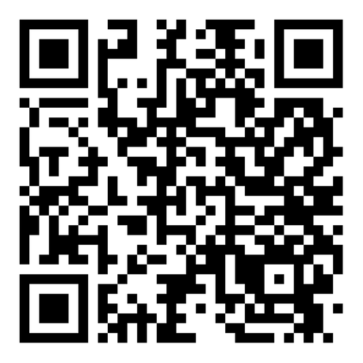
1.1 Open Call
Continuously Open
Scope: Aquaculture, fisheries, and blue economy
No submission deadlines, but recommended submission dates
Evaluation every four months
open call
1.2 Challenge Driven Calls
Every 8 months
Specific themes: EU priorities based on an internal roadmap
Submission deadlines
Review: every 8 months
aquaculture call

Slide 8
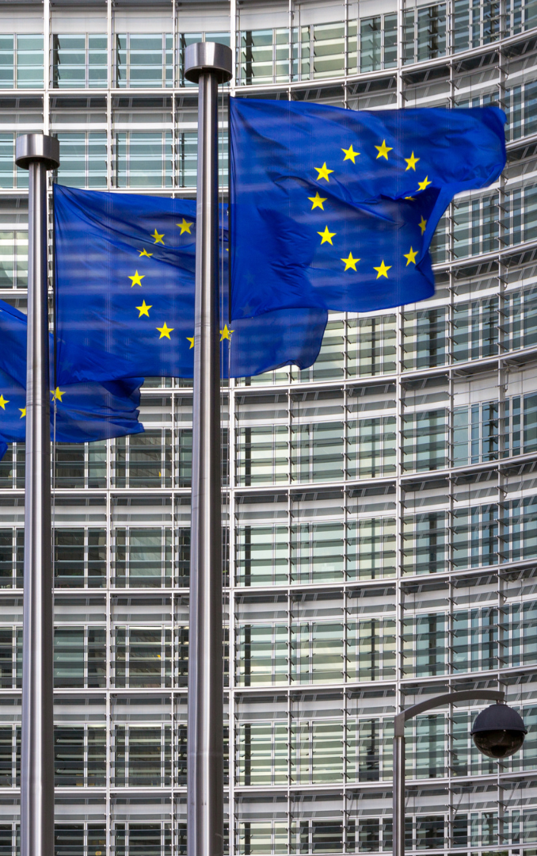
1. Funded Access
What kind of projects?
This programme offers the flexibility
to bring fresh perspectives and design research projects that explore new ideas or consolidate old ones while contributing to European policy priorities:
The European Common Fisheries Policy,
The Farm to Fork Strategy,
The Sustainable Blue Economy,
The European Green Deal
And the EU Mission "Restore our Ocean and Waters by 2030

Slide 9
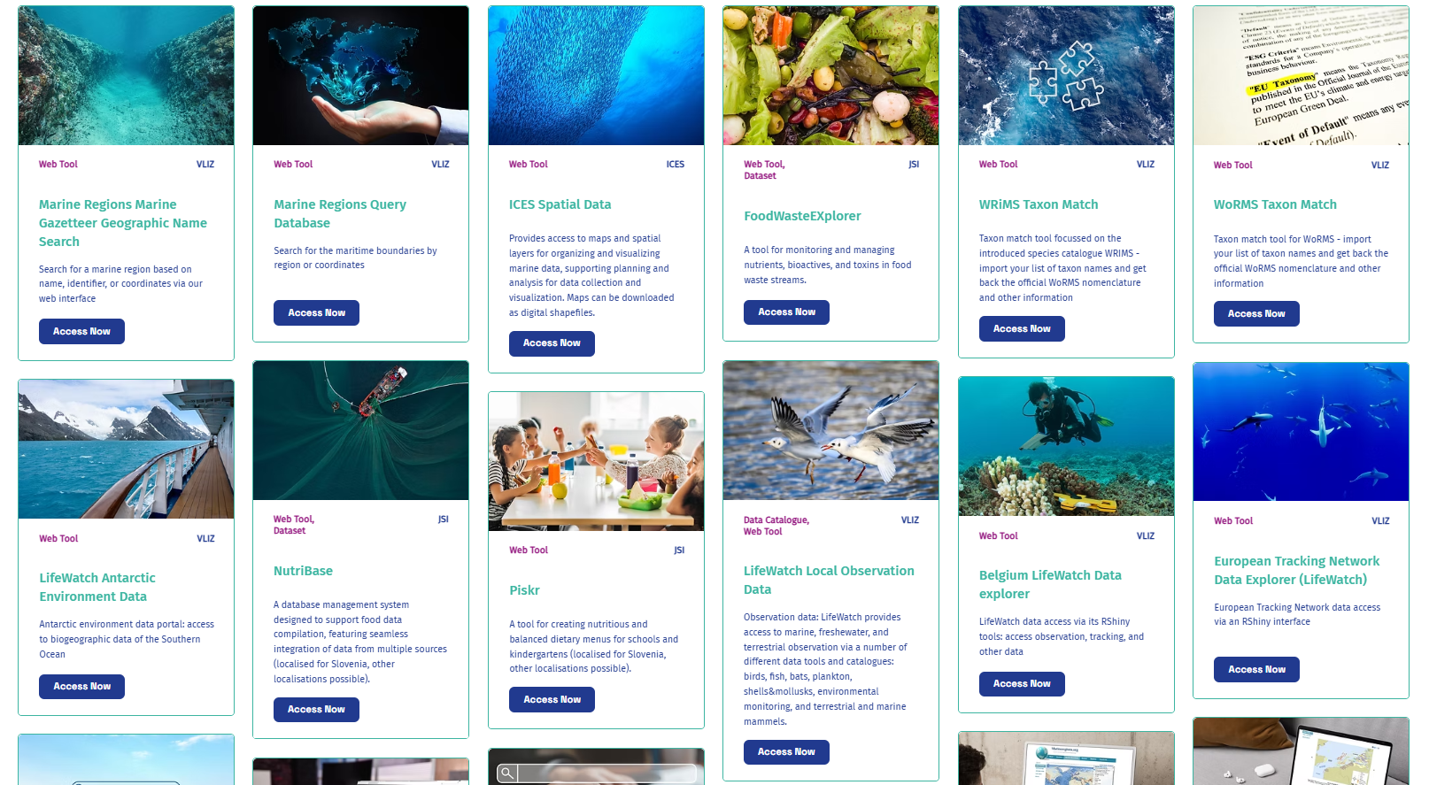

2. Virtual Access
Catalogue Online
43
different sources
Access here
aquaserv-ri.eu/virtual-access

Slide 10
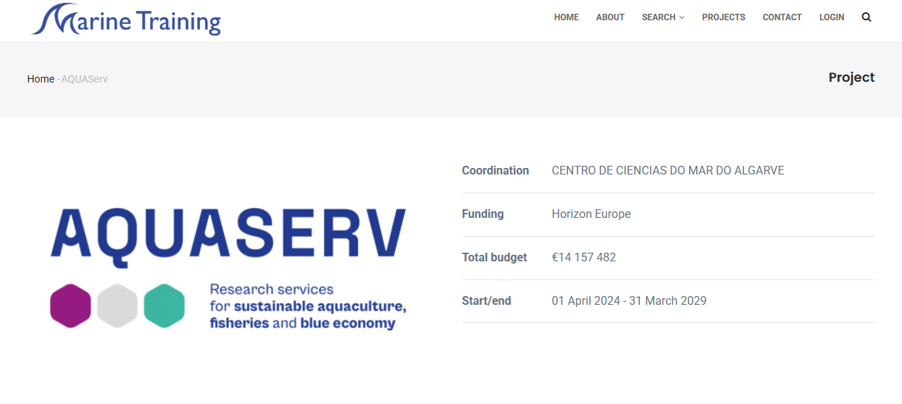

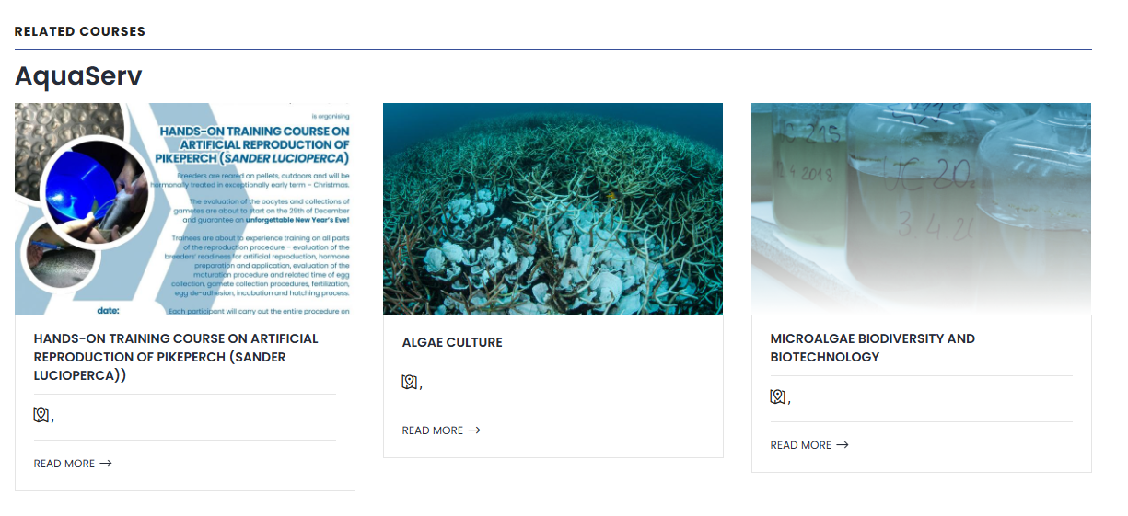
3. Training
For users
AQUASERV is dedicated to the coordination, design and delivery of comprehensive training activities to equip the new generation of researchers with the necessary skills for the efficient use of research infrastructures.
Courses organised by AQUASERV are hosted on the dedicated
e-Learning Platform.
Access here
marinetraining.eu/aquaserv

Slide 11
3. Training
Exclusive to the AQUASERV consortium
Funding to develop new online, blended, or onsite courses.
Calls are opened periodically.
Training courses
Visit a partner institution (1–3 weeks) to exchange best practices and expertise.
Funding covers travel, meals, and accommodation (up to €2,000).
The call is always open.
Staff Mobility
Notes:
Present this slide only to members of the AQUASERV consortium

Slide 12

4. Other Opportunities
Call for Service Integration and Customisation
Exclusive to the AQUASERV consortium
Provides financial support to integrate, customise and combine services:
including data FAIRness,
spanning two or more AQUASERV Research Infrastructures.
New calls will be issued approximately
every six months.
Notes:
Present this slide only to members of the AQUASERV consortium

Slide 13




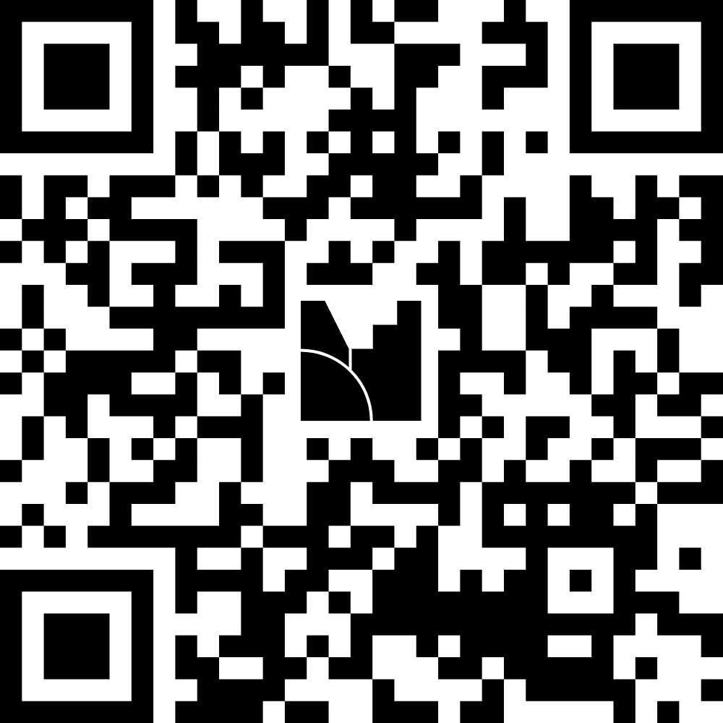
4. Stay in conversation!
Follow us and keep track of our opportunities.
Subscribe to our external newsletter
AQUASERV-RI
aquaserv.bsky.social
aquaserv-ri.eu
Notes:
Present this slide only to members of the AQUASERV consortium

Slide 14


Thank you!
Funded by the European Union. Views and opinions expressed are, however, those of the author(s) only and do not necessarily reflect those of the European Union. The European Union cannot be held responsible for them.

